Slide 1

Harmony in Complexity: Unveiling Mathematical Unity Across Logistic Regression, Artificial Neural Networks and Computer Vision
Liliang Chen
Freddie Mac
chenliliang@gmail.com

Slide 2
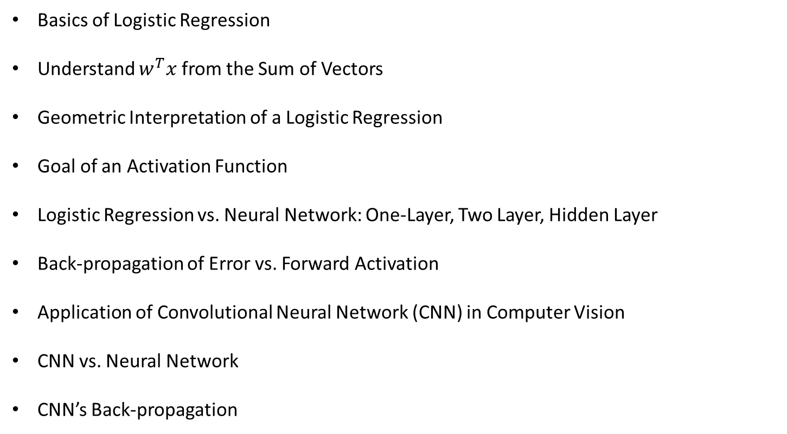
Agenda
Basics of Logistic Regression
Understand $w^{T}x$ from the Sum of Vectors
Geometric Interpretation of a Logistic Regression
Goal of an Activation Function
Logistic Regression vs. Neural Network: One-Layer, Two Layer, Hidden Layer
Back-propagation of Error vs. Forward Activation
Application of Convolutional Neural Network (CNN) in Computer Vision
CNN vs. Neural Network
CNN’s Back-propagation

Slide 3
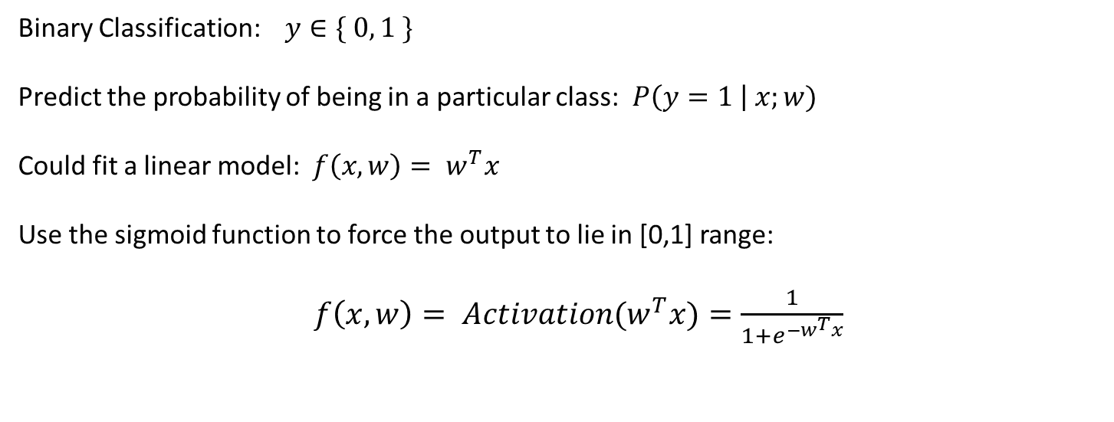
Basics of Logistic Regression
Binary Classification: $y∈\{ 0, 1 \}$
Predict the probability of being in a particular class: $P\left(y=1 \right| x;w)$
Could fit a linear model: $f\left(x,w\right)= w^{T}x$
Use the sigmoid function to force the output to lie in [0,1] range:
$f\left(x,w\right)= {Activation(w}^{T}x)=\frac{1}{1+e^{−w^{T}x}}$

Slide 4
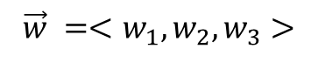

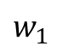
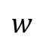

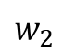
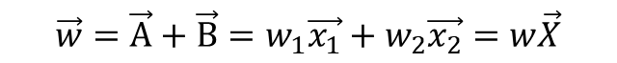
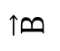
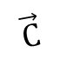
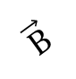
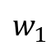
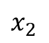
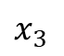
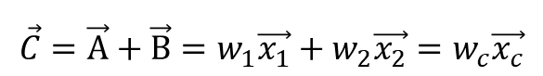
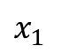
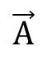
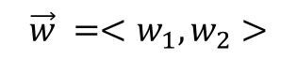
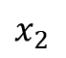
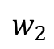
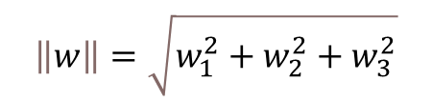
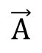
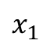

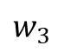
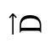
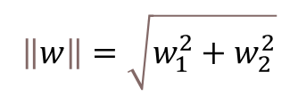
Understand $w^{T}x$ from Geometry (the Sum of Vectors)
Vector addition in 2D
Vector addition in 3D
$x_{2}$
$x_{3}$
$$\vec{w}$$
$$\vec{D}$$
$x_{2}$
$$w_{3}$$
$$\vec{w}$$
$$\vec{B}$$
$$w$$
$$w_{2}$$
$$\vec{B}$$
$$\vec{C}$$
$$w_{2}$$
$$w_{1}$$
$$\vec{A}$$
$x_{1}$
$$w_{1}$$
$$\vec{A}$$
$x_{1}$
$$\vec{w}=\vec{A}+\vec{B}=w_{1}\vec{x_{1}}+w_{2}\vec{x_{2}}=w\vec{X}$$
$$\vec{C}=\vec{A}+\vec{B}=w_{1}\vec{x_{1}}+w_{2}\vec{x_{2}}=w_{c}\vec{x_{c}}$$
$\vec{w}=\vec{C}+\vec{D}=w_{c}\vec{x_{c}}+w_{3}\vec{x_{3}}=w_{1}\vec{x_{1}}+w_{2}\vec{x_{2}}$ $+w_{3}\vec{x_{3}}$ $=w\vec{X}$
$$\vec{w} =<w_{1},w_{2}>$$
$$\vec{w} =<w_{1},w_{2},w_{3}>$$
$$\left\|w\right\|=\sqrt{w_{1}^{2}+w_{2}^{2}}$$
$$\left\|w\right\|=\sqrt{w_{1}^{2}+w_{2}^{2}+w_{3}^{2}}$$
W$e can think of w^{T}x as tranforming from multiple independent vectors$
$$into a single vector with a deterministic direction and magnitude$$

Slide 5

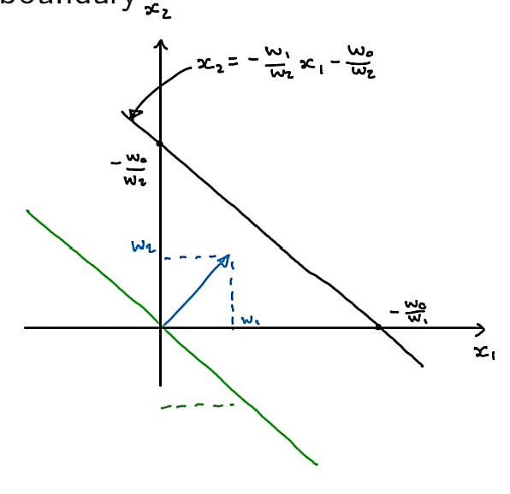

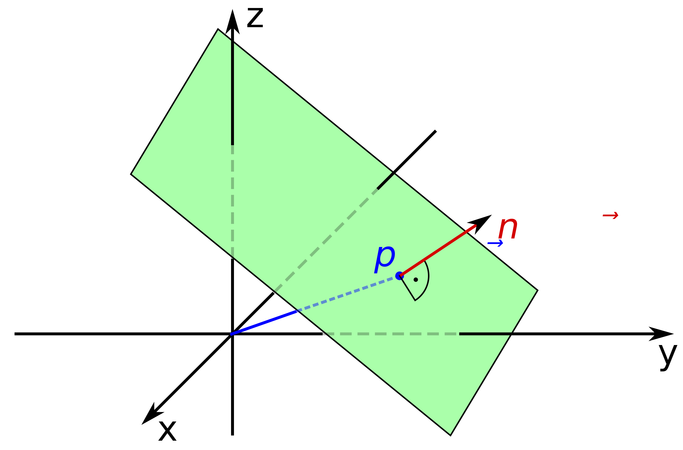

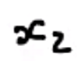

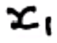
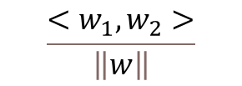

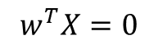

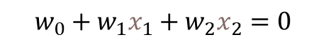
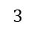
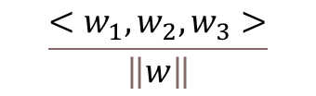
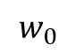
Understanding the linear model shape $w^{T}x=0 \text{from} \text{geometry}$
$$w^{T}X=0$$
defines a line in a two-dimension space vs a hyper-plane in a three-dimension space
The unit vector normal to the line/plane has the same direction as the sum of vectors based on individual vectors.
$$w_{0}+w_{1}x_{1}+w_{2}x_{2}=0$$
$$w_{0}+w_{1}x_{1}+w_{2}x_{2}+w_{3}x_{3}=0$$
The unit vector normal to this line is
$$\frac{<w_{1},w_{2}>}{\left\|w\right\|}$$
The unit vector normal to this plane is
$$\frac{<w_{1},w_{2},w_{3}>}{\left\|w\right\|}$$
$$3$$
$$\vec{w}$$
$$\vec{w}$$
$$w_{0}$$

Slide 6
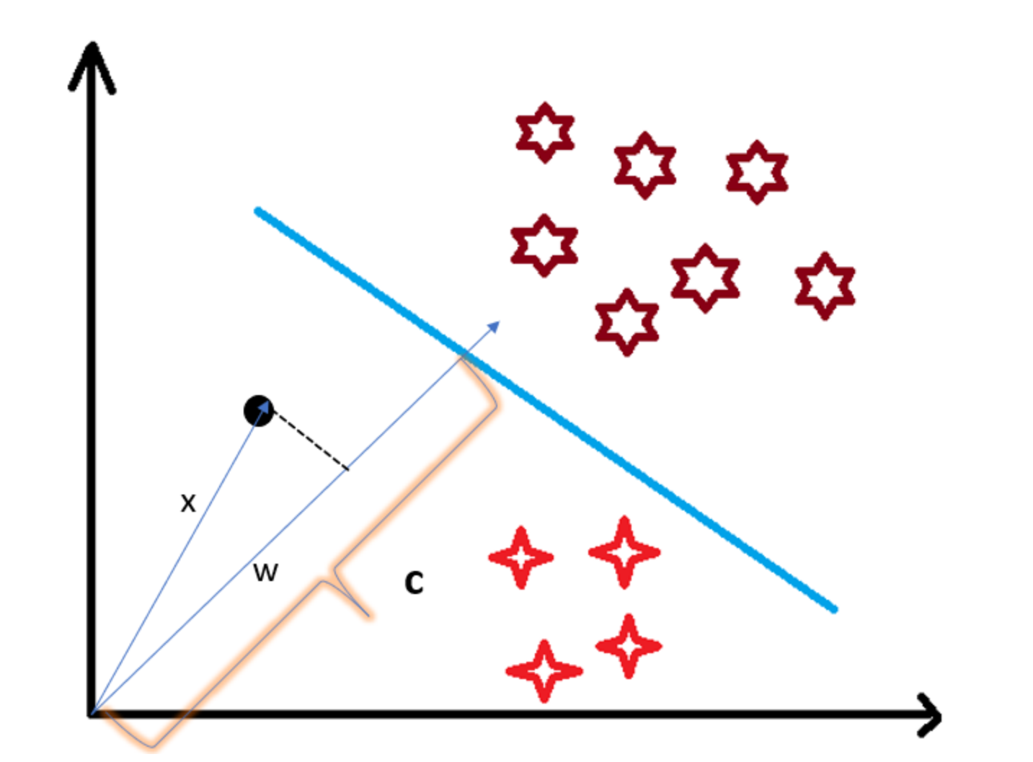
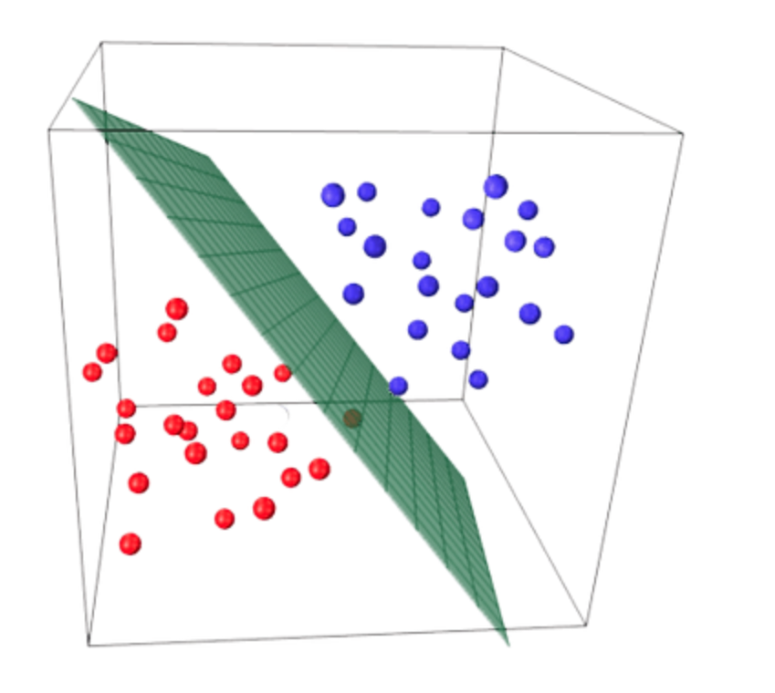




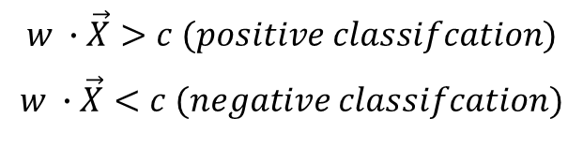
Geometric Interpretation of a Logistic Regression
Decision Boundary as a line in 2D
Decision Boundary as a hyperplane in 3D
o
Logistic regression seeks the decision boundary to perfect linear separate positive and negative points;
Classification depends on comparing relative distance from the origin to the data points vs. the decision boundary.
$$w∙\vec{X}=c (the point lies on the decision boundary)$$
$$w ∙\vec{X}>c (positive classifcation)$$
$$w ∙\vec{X}<c (negative classifcation)$$

Slide 7
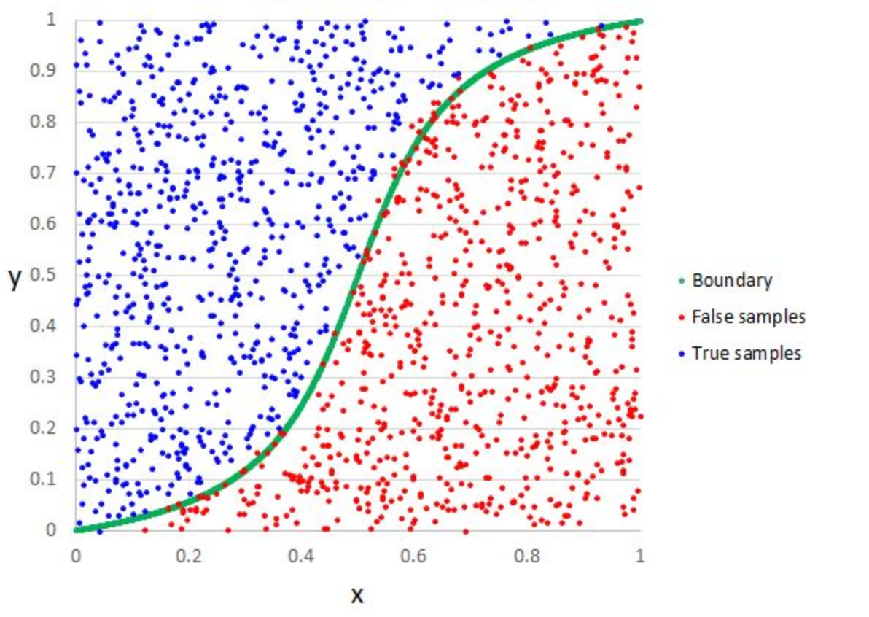

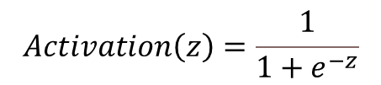
Goal of an Activation Function
Activation function translates a line into a nonlinear decision boundary in a 2D space;
Logistic regression normally choose sigmoid function as its activation function:
$$Activation\left(z\right)=\frac{1}{1+e^{−z}}$$
Decision Boundary

Slide 8
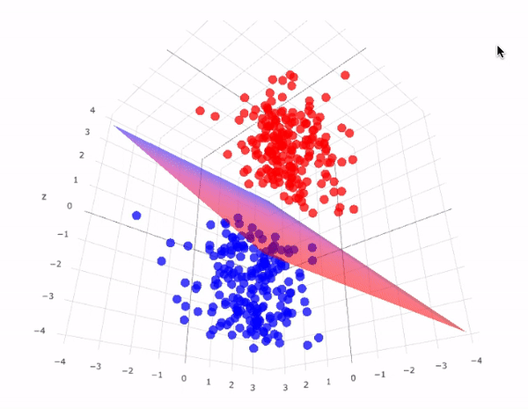
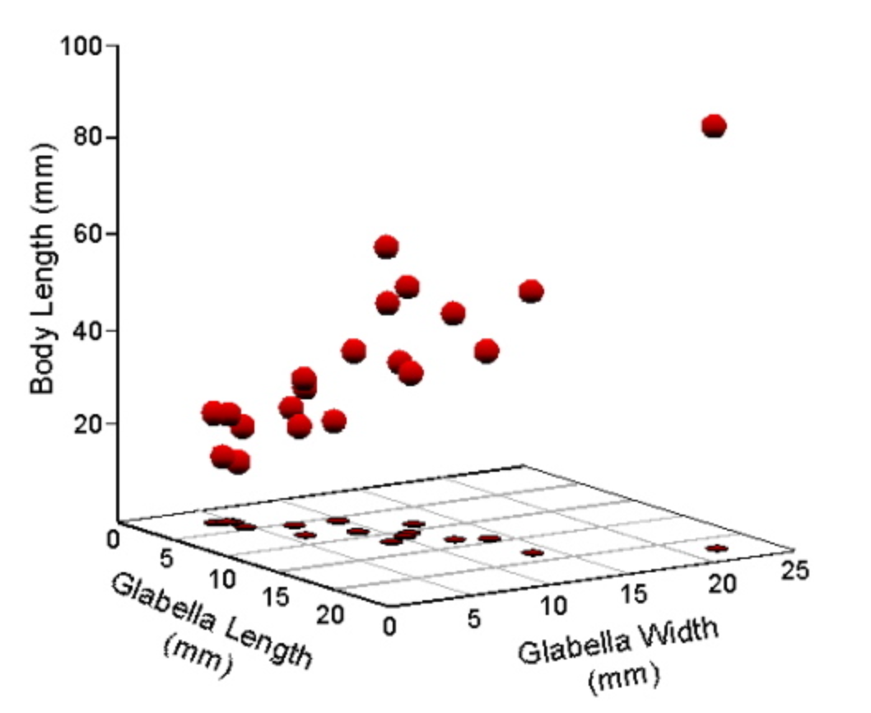



Decision Boundary in a Hyper-dimension Space
Activation function translates a hyperplane into a complex decision boundary in a higher dimension space
*Source: Deep Learning: Feed Forward Neural Networks (FFNNS) ---- Medium

Slide 9
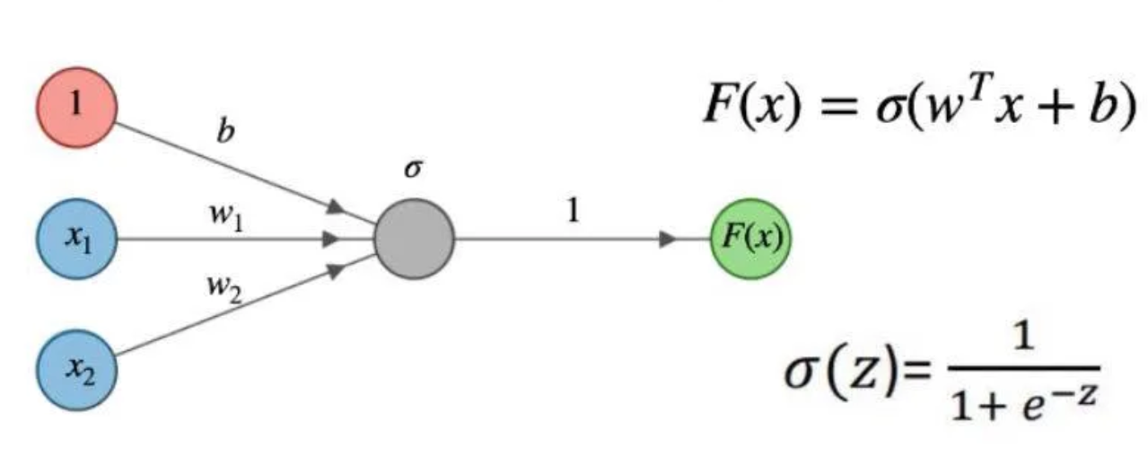


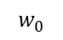
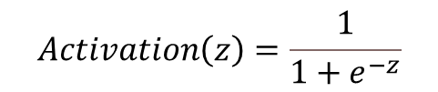
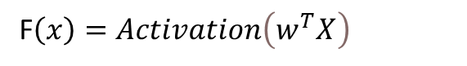
Understand logistic Regression from a One-layer Neural Network
$$w_{0}$$
One-layer neural network can be formulated as
F$\left(x\right)=Activation\left(w_{0}+w_{1}x_{1}+w_{2}x_{2}+…+w_{n}x_{n}\right)$
Rewrite using vectorized form, we get
F$\left(x\right)=Activation\left(w^{T}X\right)$
which has the same mathematical formula as a logistic regression.
Logistic regression uses below sigmoid activation function:
$$Activation\left(z\right)=\frac{1}{1+e^{−z}}$$
while a neural network can have more activation function variation.
A logistic regression can be thought of a special case of one-layer neural network.
Notes:
If we compare logistic regression with a one-layer neural network, and this is a one-layer neural network formula, F(x) is the activation function of linear combination of feature space X. here , x1​ and x2​ are the input neurons, and w represents the weights. If we rewrite it using vectorized form, we get this equation. we will notice that they are quite similar to logistic regression, the difference only lies in the activation function: logistic regression uses the sigmoid function, while a neural network can have various activation functions. In both algorithm, we are calibrating the parameter W. So technically, the goal of a logistic regression is to find a hyperplane to separate two classes, while in neural network, the goal is to find the weight which can better predict the final outcome. In this sense, logistic regression can be seen as a special case of a one-layer neural network.

Slide 10
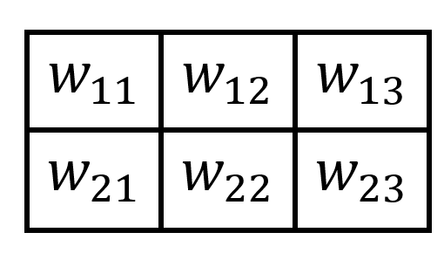
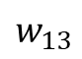
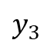
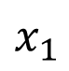
















Two-layer Neural Networks
$w_{11}$
$y_{1}$
$x_{1}$
$w_{12}$
$y_{1}$
$y_{2}$
$y_{3}$
$w_{13}$
$x_{1}$
$y_{2}$
Z
$w_{21}$
$x_{2}$
$x_{2}$
$w_{22}$
$w_{23}$
$y_{3}$
Input
Hidden Layer
Output
${\left[\begin{matrix}w_{11} & w_{12} & w_{13} \\ w_{21} & w_{22} & w_{23}\end{matrix}\right]}^{T}\left[\begin{matrix}x_{1} \\ x_{2}\end{matrix}\right]$=$\left[\begin{matrix}w_{11}x_{1}+w_{21}x_{2} \\ w_{12}x_{1}+w_{22}x_{2} \\ w_{13}x_{1}+w_{23}x_{2}\end{matrix}\right]$=$\left[\begin{matrix}y_{1} \\ y_{2} \\ y_{3}\end{matrix}\right]$
$$Y=Activation\left(w_{x}^{T}X\right)$$
$$Z=Activation\left(w_{y}^{T}Y\right)$$
Adding a layer will add the complexity of the networks, but the general forward activation form is the same

Slide 11







The Necessity of One Hidden Layer
A hidden layer is needed since the decision boundaries could be nonlinear;
We use the combination of different decision boundaries to construct the final decision boundary;
Different decision boundaries require us to adopt hidden layers with different feature space.
$$w_{11}x_{1}+w_{21}x_{2}+w_{01}=0$$
$x_{1}$
$x_{2}$
$$w_{21}x_{1}+w_{22}x_{2}+w_{02}=0$$
Notes:
People often wonder why neural networks need multiple layers and how many layers are required. To understand this, we could rely on the concept of decision boundary from logistic regression to help us. Imagine we have a decision boundary in X space, the decision boundary from X neuron has a nonlinear shape as the right chart. Therefore, direct capturing the relationship from X neuron, as logistic regression does, won’t work. To overcome this challenge, we can use multiple straight lines, each representing a small part of the overall decision boundary. The creation of the intermediate separate linear decision boundary is done through creating a hidden layer.

Slide 12











Two Hidden-layer Neural Networks
$$X$$
$$Y$$
$$Z$$
$$H$$
$$X=\left[\begin{matrix}x_{1} \\ x_{2} \\ \begin{matrix}… \\ x_{n}\end{matrix}\end{matrix}\right]$$
$$w_{x}^{T}=\left[\begin{matrix}w_{11} & w_{12} & \begin{matrix}… & w_{1n}\end{matrix} \\ w_{21} & w_{22} & \begin{matrix}… & w_{2n}\end{matrix} \\ \begin{matrix}⋯ \\ w_{m1}\end{matrix} & \begin{matrix}⋯ \\ w_{m2}\end{matrix} & \begin{matrix}\begin{matrix}⋯ & ⋯\end{matrix} \\ \begin{matrix}⋯ & w_{mn}\end{matrix}\end{matrix}\end{matrix}\right]$$
$$Y=\left[\begin{matrix}y_{1} \\ y_{2} \\ \begin{matrix}… \\ y_{n}\end{matrix}\end{matrix}\right]$$
$$Y=Activation\left(w_{x}^{T}X\right)$$
$$Z=Activation\left(w_{y}^{T}Y\right)$$
$$H=Activation\left(w_{z}^{T}T\right)$$
With more hidden layers, we have more freedom to transform between different spaces.

Slide 13









Compare Similarity of back-propagation of error with the Forward Activation
The error of each neuron is proportional to its weight:
$$E\left(x_{1}\right)=\frac{w_{11}}{w_{11}+w_{21}}E\left(y_{1}\right)+\frac{w_{12}}{w_{12}+w_{22}}E\left(y_{2}\right)+\frac{w_{13}}{w_{13}+w_{23}}E\left(y_{3}\right)$$
$w_{11}$
$y_{1}$
$x_{1}$
$w_{12}$
$$E\left(x_{2}\right)=\frac{w_{21}}{w_{11}+w_{21}}E\left(y_{1}\right)+\frac{w_{22}}{w_{12}+w_{22}}E\left(y_{2}\right)+\frac{w_{23}}{w_{13}+w_{23}}E\left(y_{3}\right)$$
$w_{13}$
$y_{2}$
Z
$w_{21}$
$$\left[\begin{matrix}\left.{E\left(x\right.}_{1}\right) \\ \left.{E\left(x\right.}_{2}\right)\end{matrix}\right]=\left[\begin{matrix}\frac{w_{11}}{w_{11}+w_{21}} & \frac{w_{12}}{w_{12}+w_{22}} & \frac{w_{13}}{w_{13}+w_{23}} \\ \frac{w_{21}}{w_{11}+w_{21}} & \frac{w_{22}}{w_{12}+w_{22}} & \frac{w_{23}}{w_{13}+w_{23}}\end{matrix}\right]\left[\begin{matrix}\left.{E\left(y\right.}_{1}\right) \\ \left.{E\left(y\right.}_{2}\right) \\ \left.{E\left(y\right.}_{3}\right)\end{matrix}\right]$$
$x_{2}$
$w_{22}$
$w_{23}$
$y_{3}$
Output
Normalize above equation to simplify it as:
Input
Hidden Layer
$$\left[\begin{matrix}\left.{E\left(x\right.}_{1}\right) \\ \left.{E\left(x\right.}_{2}\right)\end{matrix}\right]=\left[\begin{matrix}w_{11} & w_{12} & w_{13} \\ w_{21} & w_{22} & w_{23}\end{matrix}\right]\left[\begin{matrix}\left.{E\left(y\right.}_{1}\right) \\ \left.{E\left(y\right.}_{2}\right) \\ \left.{E\left(y\right.}_{3}\right)\end{matrix}\right]$$
Forward activation has same multiplier
Below is a general equation of the back-propagation algorithm
Y$= w^{T}X$
$$E_{n}=w^{T}E_{n+1}$$
Adjust weight based on
$$w_{i}^{n}=w_{i}^{n}−α\frac{∂E_{n}}{∂w_{i}^{n}}$$

Slide 14

Application of Convolutional Neural Network (CNN) in Computer Vision
Convolutional Neural Networks (CNN) are a type of neural network
widely used in images recognition, images classifications, and objects detections
Computer reads images as pixels and expresses them as matrix
Three basic components: Convolution layer, Flatten layer, Fully connected layer
Filter (Kernel) is worked as the weight
Source: What is Convolutional Neural Network – CNN (Deep Learning)
Notes:
Neural networks have been around since 1940s, but they didn’t gain much attention until 1990s. (In the early 2000s, there were significant advancements in deep learning techniques, ) In the mid-2010s Convolutional Neural Networks became a game-changer in computer vision, which we called it CNN. CNNs have revolutionized image recognition tasks, achieving remarkable accuracy.
Transitioning from neural networks to computer vision, convolutional neural networks (CNNs) became the go-to algorithm in computer vision. Here, we aim to understand how CNNs is related to artificial neural network.
Here is a general flow of the computer vision process
Reading from Pixels: The computer starts by reading pixeles from an image. It does this using a thing called a kernel, which performs a convolution transformation on the image.
RELU Filtering: After convolution transformation, the output goes through a RELU filter, which helps identify important features in the image.
Flattening: Next, the data is flattened from a 2D matrix to a one-dimensional vector. This makes it easier for the neural network to process.
Fully Connected Layer: Finally, the flattened data is passed to a traditional neural network, which builds a fully connected layer.
As we can see here, the right side are still artificial neural network, what make it different is the left part which is convolutional layer. When we think of the kernel, we can view it as the weights in a neural network.

Slide 15






















Convolutional Neural Network
$x_{1}$
$$w_{1}$$
$x_{2}$
Input Image
Filter
Feature Map
$$w_{2}$$
$x_{3}$
$y_{1}$
$$x_{1}$$ | $$x_{2}$$ | $$x_{3}$$
$$x_{4}$$ | $$x_{5}$$ | $$x_{6}$$
$$x_{7}$$ | $$x_{8}$$ | $$x_{9}$$
$$y_{1}$$ | $$y_{2}$$
$$y_{3}$$ | $$y_{4}$$
$$w_{3}$$
$$∗$$
$$w_{1}$$ | $$w_{2}$$
$$w_{3}$$ | $$w_{4}$$
=
$x_{4}$
$y_{2}$
$$w_{4}$$
$x_{5}$
$y_{3}$
The forward pass of the convolutional layer
${y_{1}=w}_{1}x_{1}+$ $w_{2}x_{2}$+ $w_{3}x_{4}$+ $w_{4}x_{5}$
$x_{6}$
$y_{4}$
$x_{7}$
$x_{8}$
$x_{9}$

Slide 16




















Convolutional Neural Network
$x_{1}$
$x_{2}$
Input Image
Kernel
Feature Map
$$w_{1}$$
$$x_{1}$$ | $$x_{2}$$ | $$x_{3}$$
$$x_{4}$$ | $$x_{5}$$ | $$x_{6}$$
$$x_{7}$$ | $$x_{8}$$ | $$x_{9}$$
$x_{3}$
$y_{1}$
$$∗$$
$$w_{1}$$ | $$w_{2}$$
$$w_{3}$$ | $$w_{4}$$
=
$$y_{1}$$ | $$y_{2}$$
$$y_{3}$$ | $$y_{4}$$
$$w_{2}$$
$x_{4}$
$y_{2}$
$$w_{3}$$
$x_{5}$
$y_{3}$
The forward pass of the convolutional layer
$y_{2}$ ${=w}_{1}x_{2}+w_{2}x_{3}+w_{3}x_{5}$ $+w_{4}x_{6}$
$$w_{4}$$
$x_{6}$
$y_{4}$
$x_{7}$
$x_{8}$
$x_{9}$
Notes:
Similarly, y2 is equal to ${=w}_{1}x_{2}+w_{2}x_{3}+w_{3}x_{5}$ $+w_{4}x_{6}$. And we can see our connections are moving down.

Slide 17




















Convolutional Neural Network
$x_{1}$
$x_{2}$
Input Image
Kernel
Feature Map
$$x_{1}$$ | $$x_{2}$$ | $$x_{3}$$
$$x_{4}$$ | $$x_{5}$$ | $$x_{6}$$
$$x_{7}$$ | $$x_{8}$$ | $$x_{9}$$
$x_{3}$
$y_{1}$
$$∗$$
$$w_{1}$$ | $$w_{2}$$
$$w_{3}$$ | $$w_{4}$$
=
$$y_{1}$$ | $$y_{2}$$
$$y_{3}$$ | $$y_{4}$$
$x_{4}$
$$w_{1}$$
$y_{2}$
$x_{5}$
$$w_{2}$$
$y_{3}$
The forward pass of the convolutional layer
$y_{3}$ ${=w}_{1}x_{4}+w_{2}x_{5}+w_{3}x_{7}$ $+w_{4}x_{8}$
$x_{6}$
$$w_{3}$$
$y_{4}$
$x_{7}$
$$w_{4}$$
$x_{8}$
$x_{9}$

Slide 18













Convolutional Neural Network
$x_{1}$
$x_{2}$
Input Image
Kernel
Feature Map
$$x_{1}$$ | $$x_{2}$$ | $$x_{3}$$
$$x_{4}$$ | $$x_{5}$$ | $$x_{6}$$
$$x_{7}$$ | $$x_{8}$$ | $$x_{9}$$
$x_{3}$
$y_{1}$
$$∗$$
$$w_{1}$$ | $$w_{2}$$
$$w_{3}$$ | $$w_{4}$$
=
$$y_{1}$$ | $$y_{2}$$
$$y_{3}$$ | $$y_{4}$$
$x_{4}$
$y_{2}$
$x_{5}$
$$w_{1}$$
$y_{3}$
The forward pass of the convolutional layer
$y_{4}$ ${=w}_{1}x_{5}+w_{2}x_{6}+w_{3}x_{8}$ $+w_{4}x_{9}$
$x_{6}$
$$w_{2}$$
$y_{4}$
If we generalize the forward pass:
$$w_{3}$$
Y $=conv(w∗X)$
$x_{7}$
$x_{8}$
$$w_{4}$$
Convolutional Multiply
$x_{9}$

Slide 19















































Comparison of Neural Networks vs Convolutional Neural Networks
$x_{1}$
$y_{1}$
$y_{2}$
$y_{3}$
$y_{4}$
$y_{1}$
$y_{2}$
$y_{3}$
$y_{4}$
$x_{1}$
$x_{1}$
$x_{2}$
$x_{2}$
$x_{2}$
$x_{3}$
$x_{3}$
$y_{1}$
$x_{3}$
$y_{1}$
$x_{4}$
$x_{4}$
$y_{2}$
$x_{5}$
$x_{4}$
$y_{2}$
$x_{6}$
$x_{5}$
$y_{3}$
$x_{5}$
$y_{3}$
$x_{7}$
$y_{4}$
$x_{8}$
$x_{6}$
$y_{4}$
$x_{6}$
$x_{9}$
$x_{7}$
$x_{7}$
$$Y=Activation\left(w^{T}X\right)$$
Y $=conv(w∗X)$
$x_{8}$
$x_{8}$
Difficult to understand
More weight parameter
Global impact from input
Can be visually understandable
Fewer weight due to weight sharing
Localized impact from input
$x_{9}$
$x_{9}$

Slide 20


















Convolutional Neural Network Back-propagation
$x_{1}$
Input Image
Kernel
Feature Map
$x_{2}$
$$x_{1}$$ | $$x_{2}$$ | $$x_{3}$$
$$x_{4}$$ | $$x_{5}$$ | $$x_{6}$$
$$x_{7}$$ | $$x_{8}$$ | $$x_{9}$$
$x_{3}$
$y_{1}$
$$∗$$
$$w_{1}$$ | $$w_{2}$$
$$w_{3}$$ | $$w_{4}$$
=
$$y_{1}$$ | $$y_{2}$$
$$y_{3}$$ | $$y_{4}$$
$x_{4}$
$y_{2}$
$Z$
$L$
Weight adjustment is:
$x_{5}$
$y_{3}$
$$w_{i}^{n}=w_{i}^{n−1}−α\frac{∂L}{∂w_{i}}$$
$x_{6}$
$y_{4}$
The loss gradient based on the chain rule
$x_{7}$
$\frac{∂L}{∂w_{i}}=$ $\frac{∂L}{∂z}\frac{∂z}{∂y_{j}}\frac{∂y_{j}}{∂w_{i}}=\frac{∂L}{∂y_{1}}\frac{∂y_{1}}{∂w_{i}}+\frac{∂L}{∂y_{2}}\frac{∂y_{2}}{∂w_{i}}+\frac{∂L}{∂y_{3}}\frac{∂y_{3}}{∂w_{i}}$ $+\frac{∂L}{∂y_{4}}\frac{∂y_{4}}{∂w_{i}}$
$x_{8}$
$x_{9}$

Slide 21














Convolutional Neural Network Back-propagation
Convolutional function of forward pass
Local gradient w.r.t the filter
$y_{1}$ ${=w}_{1}x_{1}+w_{2}x_{2}+w_{3}x_{4}$ $+w_{4}x_{5}$
$\frac{∂y_{1}}{∂w_{1}}$=$x_{1}$ | $\frac{∂y_{1}}{∂w_{2}}$=$x_{2}$ | $\frac{∂y_{1}}{∂w_{3}}$=$x_{4}$ | $\frac{∂y_{1}}{∂w_{4}}\text{=}x_{5}$
$\frac{∂y_{2}}{∂w_{1}}$=$x_{2}$ | $\frac{∂y_{2}}{∂w_{2}}$=$x_{3}$ | $\frac{∂y_{2}}{∂w_{3}}$=$x_{5}$ | $\frac{∂y_{2}}{∂w_{4}}\text{=}x_{6}$
$\frac{∂y_{3}}{∂w_{1}}$=$x_{4}$ | $\frac{∂y_{3}}{∂w_{2}}$=$x_{5}$ | $\frac{∂y_{3}}{∂w_{3}}$=$x_{7}$ | $\frac{∂y_{3}}{∂w_{4}}\text{=}x_{8}$
$\frac{∂y_{4}}{∂w_{1}}$=$x_{5}$ | $\frac{∂y_{4}}{∂w_{2}}$=$x_{6}$ | $\frac{∂y_{4}}{∂w_{3}}$=$x_{8}$ | $\frac{∂y_{4}}{∂w_{4}}\text{=}x_{9}$
$y_{2}$ ${=w}_{1}x_{2}+w_{2}x_{3}+w_{3}x_{5}$ $+w_{4}x_{6}$
$y_{3}$ ${=w}_{1}x_{4}+w_{2}x_{5}+w_{3}x_{7}$ $+w_{4}x_{8}$
$y_{4}$ ${=w}_{1}x_{5}+w_{2}x_{6}+w_{3}x_{8}$ $+w_{4}x_{9}$
Loss gradient w.r.t the filter
$$\frac{∂L}{∂w_{1}}=\frac{∂L}{∂y_{1}}x_{1}+\frac{∂L}{∂y_{2}}x_{2}+\frac{∂L}{∂y_{3}}x_{4}+\frac{∂L}{∂y_{4}}x_{5}$$
Rewrite using convolutional operator
$$\frac{∂L}{∂w_{2}}=\frac{∂L}{∂y_{1}}x_{1}+\frac{∂L}{∂y_{2}}x_{3}+\frac{∂L}{∂y_{3}}x_{5}+\frac{∂L}{∂y_{4}}x_{6}$$
$$\frac{∂L}{∂w_{1}}$$ | $$\frac{∂L}{∂w_{2}}$$
$$\frac{∂L}{∂w_{3}}$$ | $$\frac{∂L}{∂w_{4}}$$
$$x_{1}$$ | $$x_{2}$$ | $$x_{3}$$
$$x_{4}$$ | $$x_{5}$$ | $$x_{6}$$
$$x_{7}$$ | $$x_{8}$$ | $$x_{9}$$
$$\frac{∂L}{∂y_{1}}$$ | $$\frac{∂L}{∂y_{2}}$$
$$\frac{∂L}{∂y_{3}}$$ | $$\frac{∂L}{∂y_{4}}$$
=
Conv
$$∗$$
$$\frac{∂L}{∂w_{2}}=\frac{∂L}{∂y_{1}}x_{4}+\frac{∂L}{∂y_{2}}x_{5}+\frac{∂L}{∂y_{3}}x_{7}+\frac{∂L}{∂y_{4}}x_{8}$$
$$\frac{∂L}{∂w_{2}}=\frac{∂L}{∂y_{1}}x_{5}+\frac{∂L}{∂y_{2}}x_{6}+\frac{∂L}{∂y_{3}}x_{8}+\frac{∂L}{∂y_{4}}x_{9}$$
$\frac{∂L }{∂w}$ = Conv ( $\frac{∂L}{∂Y}\text{∗}\text{X})$
Notes:
Previously, we already know each y is a result of convolution multiplying between kernel W and input feature X. We can calculate the local gradient of y with respect to each weight, go to the board to talk***, then we use this to replace that global loss gradient equation, If we rewrite that using convolution operation, and we notice the loss gradient to weight is the convolutional multiplying between input feature X and loss function with respect to y, *** go to the board to explain. once we got this, we can use it in the weight adjustment function. What is interesting here is no matter in the forward activation or the back-propagation of loss, we both have this X here, and both can be express through the convolutional form.

Slide 22

Conclusion

Slide 23
Thanks!

